Slide 1
BR US discount sensitivity model
MARCH 2017
PLATFORM ANALYTICS

Slide 2


BACKGROUND
Objective:
Every year company shells out billions of $ in various discounts offered.
Not all Customers have affinity towards discounts to make a purchase.
This creates an opportunity to improve margin by offering relevant discounts to customers based on how discount sensitive they are.
The whole exercise will help in:
Increasing Revenue
Saving Cost
Definitions:
Response: customers taking above 35% of gross sales as discounts in an year
Response score: Probability of a customer to search discount above 35% to make purchase
Historical behavior
Response Window
Training
Transactions & Browse Data
Jan2015-Dec2015
Purchase Data
Jan2016-Dec2016
Validation
Transactions & Browse Data
Jul’14-Jun’15 and Feb’14-Jan’15
Purchase Data
Jul’15-Jun’16 and Feb’15-Jan’16
Algorithms | Library
Ensemble Leaners | xgboost, ada, adabag, gbm, randomForest
Support Vector Machines | kernlab
Logistic Regression
Deep Learning | mxnet, h2o, tensorflow, darch, scikit-learn
Data preparation
Exploratory Analysis
Scaling and Outlier Treatment
Dataset Size involved : 4.7M (Customer Keys), Response – 20.2%
Model Execution and Testing
Model Evaluation and Validation
Model Training

Slide 3
PREDICTORS AND RELATIVE IMPORTANCE

Slide 4
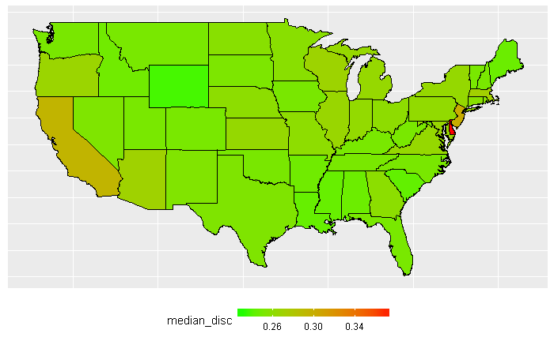
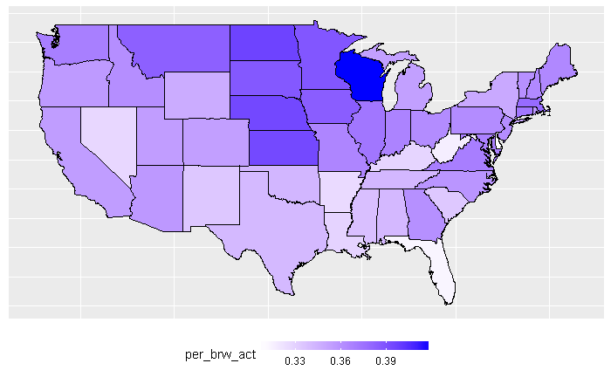
INTERESTING FACTS ABOUT DISCOUNT TAKEN
Certain States exhibit more discount sensitive character than others
We can see the same states are more online active
Discount rates at online purchases are more than retail purchase which explains this characteristic

Slide 5
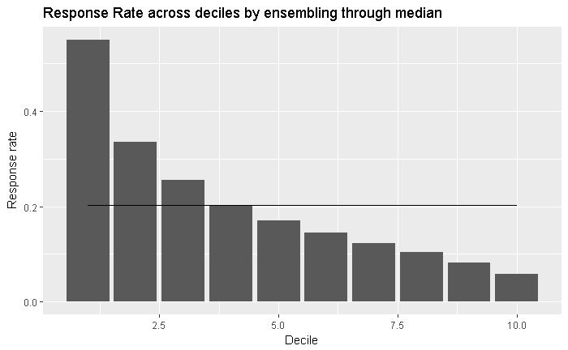
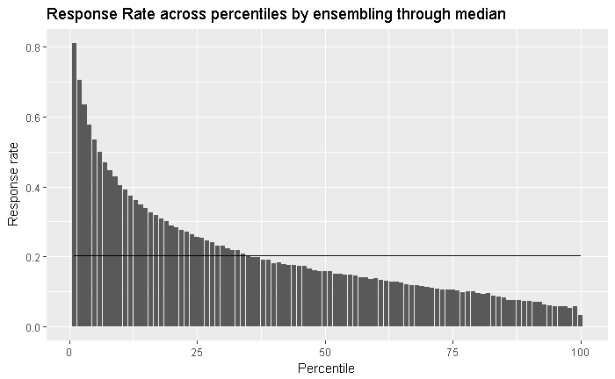
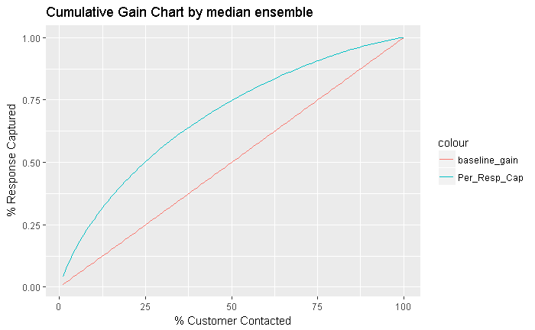
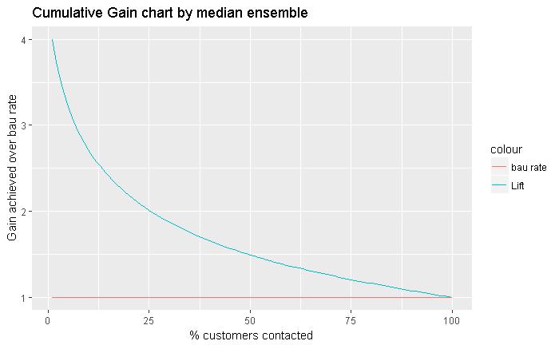
MODEL RESULTS - VALIDATIONS JUL 15-JUN 16
Decile | Customers | Number of Responder | Cum Responders | Response Rate | Response Gain | Cumulative Response Rate | Cumulative Lift
1 | 472,243 | 260,026 | 260,026 | 55.1% | 27.2% | 55.1% | 2.72
2 | 472,244 | 158,415 | 418,441 | 33.5% | 43.7% | 44.3% | 2.19
3 | 472,243 | 120,468 | 538,909 | 25.5% | 56.3% | 38.0% | 1.88
4 | 472,244 | 95,893 | 634,802 | 20.3% | 66.3% | 33.6% | 1.66
5 | 472,244 | 80,267 | 715,069 | 17.0% | 74.7% | 30.3% | 1.49
6 | 472,243 | 68,752 | 783,821 | 14.6% | 81.9% | 27.7% | 1.37
7 | 472,244 | 58,311 | 842,132 | 12.3% | 88.0% | 25.5% | 1.26
8 | 472,243 | 48,850 | 890,982 | 10.3% | 93.1% | 23.6% | 1.16
9 | 472,244 | 38,555 | 929,537 | 8.2% | 97.1% | 21.9% | 1.08
10 | 472,244 | 27,395 | 956,932 | 5.8% | 100.0% | 20.3% | 1.00
Model Summary:
Among many models , GBM algorithm was picked based on model performance.
Out of 2000 GBM models, best 20 have been picked and data is scored . Ensemble of median score was taken as final probability which was used for validation
Response Rate across deciles by median score from 20 models
Response Rate across percentiles by median score from 20 models
Cum Gains using median score from 20 models
Cum Lift using median score from 20 models

Slide 6
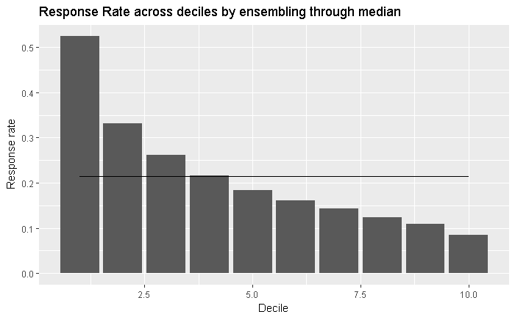
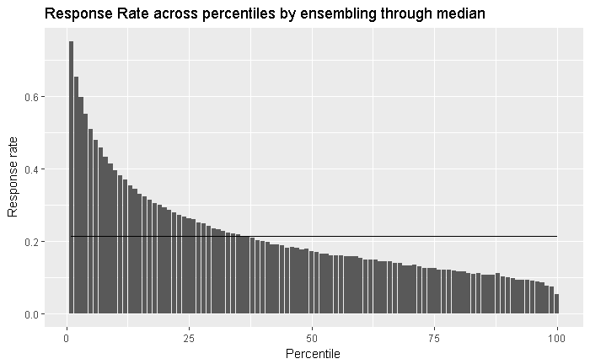
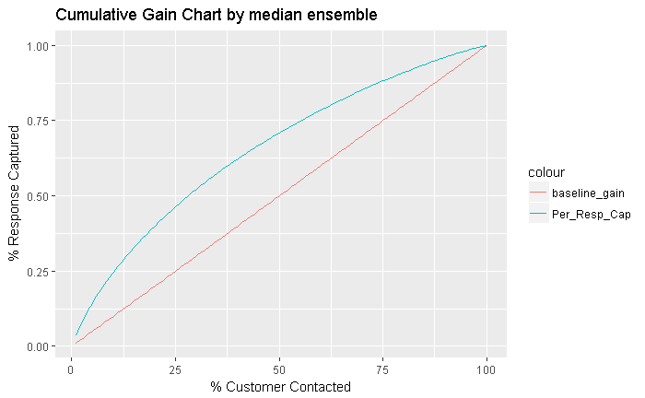
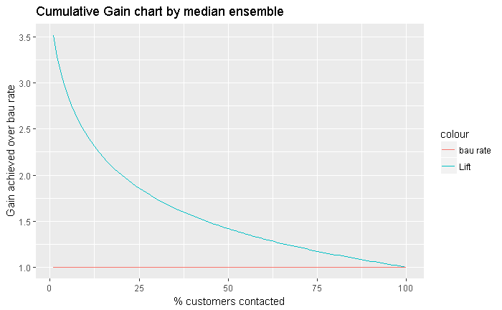
MODEL RESULTS – VALIDATIONS FEB15-JAN16 …
Decile | Customers | Number of Responder | Cum Responders | Response Rate | Response Gain | Cumulative Response Rate | Lift
1 | 410,545 | 215,593 | 215,593 | 52.51% | 24.53% | 52.51% | 2.45
2 | 410,545 | 136,164 | 351,757 | 33.17% | 40.03% | 42.84% | 2.00
3 | 410,545 | 107,103 | 458,860 | 26.09% | 52.21% | 37.26% | 1.74
4 | 410,545 | 88,788 | 547,648 | 21.63% | 62.32% | 33.35% | 1.56
5 | 410,545 | 75,739 | 623,387 | 18.45% | 70.93% | 30.37% | 1.42
6 | 410,545 | 66,164 | 689,551 | 16.12% | 78.46% | 27.99% | 1.31
7 | 410,545 | 58,678 | 748,229 | 14.29% | 85.14% | 26.04% | 1.22
8 | 410,545 | 51,056 | 799,285 | 12.44% | 90.95% | 24.34% | 1.14
9 | 410,545 | 44,795 | 844,080 | 10.91% | 96.05% | 22.84% | 1.07
10 | 410,545 | 34,751 | 878,831 | 8.46% | 100.00% | 21.41% | 1.00
Model Summary:
Among many models , GBM algorithm was picked based on model performance.
Out of 2000 GBM models, best 20 have been picked and data is scored . Ensemble of median score was taken as final probability which was used for validation

Slide 7
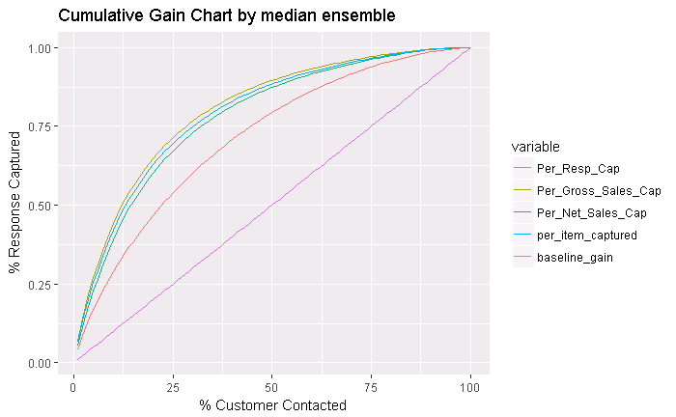
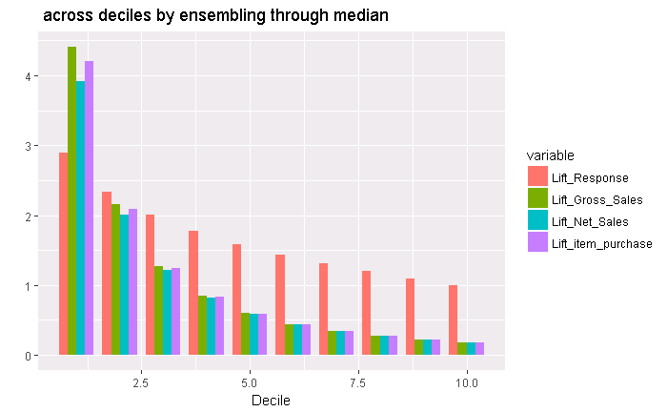
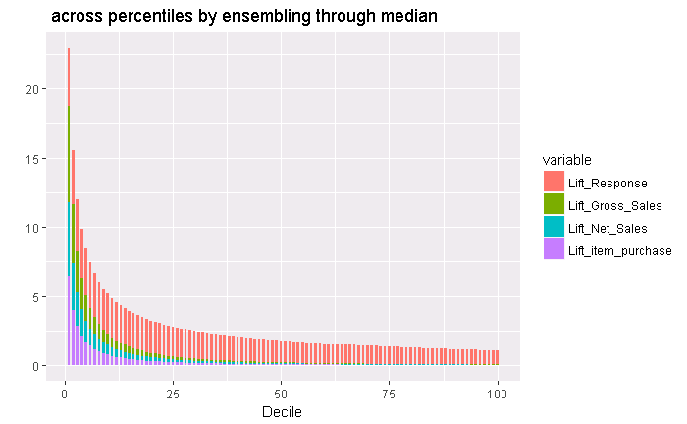
MODEL RESULTS – VALIDATIONS FEB15-JAN16
Barplot of Gain by decile for median ensemble
Gain over several parameters like net sales, gross sales , item quantity etc. are consistent across decile and percentiles
Waterfall is being maintained throughout
Cumulative Percentage gain
Barplot of Gain by percentile for median ensemble

Slide 8
APPENDIX

